Slide 1

Unit-III

Slide 2
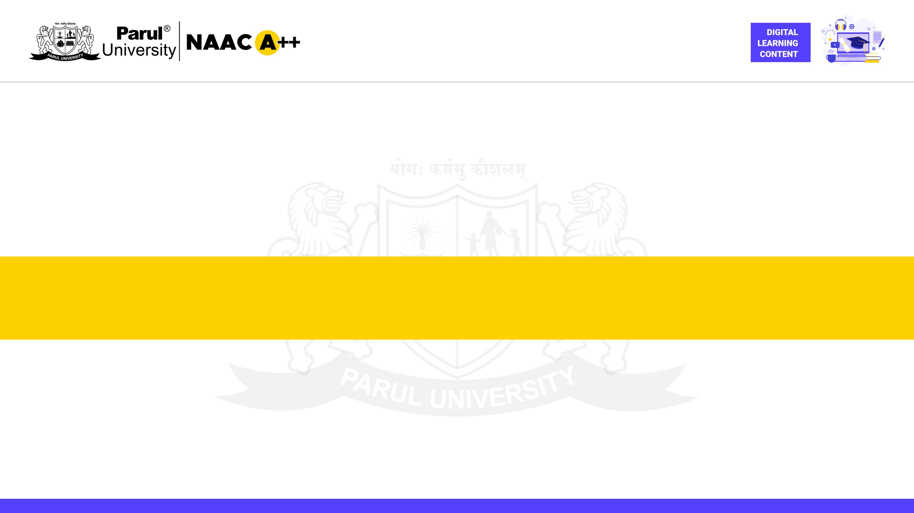
CHAPTER 3
JSP: Java Server Programming

Slide 3

Introduction

Slide 4
What are Java Server Pages (JSP)?
JSP is a server-side technology used to develop dynamic web content.
It combines HTML tags with snippets of Java code embedded within.
JSP pages are compiled into Java Servlet before execution on the server.
This allows for dynamic content generation based on user requests or server-side logic.

Slide 5
Purpose of JSP
Create dynamic web pages that adapt to user input and server-side conditions.
Generate content based on database queries, user sessions, or application logic.
Facilitate interaction with various back-end resources like databases and web services.
Simplify development by separating presentation logic (HTML) from business logic (Java code).
Enhance user experience with interactive features and personalized content.

Slide 6
Importance of JSP in Web Development
Promotes separation of concerns, making code more maintainable and reusable.
Reduces development time by offering pre-defined tags and expression language.
Enables seamless integration with Java frameworks and libraries.
Offers a mature and widely adopted technology with a large developer community.
Provides a cost-effective solution for building dynamic web applications.

Slide 7
JSP Architecture

Slide 8
Translation - From Script to Servlet
The very first step in the JSP life cycle.
The JSP container translates the JSP page into a corresponding Servlet class.
This Servlet class is essentially a Java program that mirrors the structure of the JSP page.
During translation, JSP tags are converted into equivalent Java code snippets.

Slide 9
Definition and Syntax
The translated Servlet class undergoes compilation.
The Java compiler converts the human-readable Java code into bytecode, the machine-readable instructions that the Java Virtual Machine (JVM) can comprehend.
A successful compilation results in a .class file, representing the compiled version of the Servlet class.

Slide 10
Execution - The Powerhouse of JSP
The heart of the JSP life cycle, where the magic happens.
The JSP container loads the compiled Servlet class (.class file) into memory.
An instance of the Servlet class is created.
The container invokes lifecycle methods of the servlet class, including jspInit(), _jspService(), and jspDestroy().
Within the _jspService() method, the container processes user requests, interacts with back-end resources like databases, and generates dynamic content that is ultimately sent back to the browser as HTML.

Slide 11
Scripting Elements

Slide 12
JSP scripting elements are designated by special tags that enclose Java code.
These tags enable developers to seamlessly embed Java code within their JSP pages.
There are three primary types of scripting elements, each serving a distinct purpose:
Scriptlets (<% %>: Used for executing multiple lines of Java code.
Expressions (<%= %>) : Employed to embed expressions that evaluate to a single value.
Declarations (<%! %>) : Utilized to declare variables and methods with class-level scope.

Slide 13
Scriptlets

Slide 14
Scriptlets (<% %>)
Scriptlets are enclosed within the <% %> tags.
They enable developers to execute multiple lines of Java code within a JSP page.
Scriptlets offer a flexible approach to incorporating Java logic directly into the JSP code structure.
Scriptlets offer greater control over logic flow and can be used for various purposes, including:
Performing calculations
Accessing and manipulating objects
Interacting with databases
Conditional statements and loops

Slide 15
Usage and Examples
Scriptlets can be used for a variety of purposes, including:
Performing calculations on the server-side before content is rendered.
Accessing and manipulating objects, such as database connections or user input.
Implementing conditional statements (if/else) and loops (for/while) to control the flow of logic within the scriptlet.
Interacting with back-end resources like databases to fetch or store data dynamically.

Slide 16
Example: Conditional Statements with Scriptlets:
Scriptlets can be used to implement conditional statements for dynamic content.
The following example displays a message based on a user's age:
Java
<%
int age = 20; // Assuming you have retrieved the //user's age
if (age >= 18) {
%>
You are eligible to vote.
<%
} else {
%>
You are not eligible to vote.
<%
}
%>

Slide 17
Scriptlets offer a powerful mechanism for embedding Java logic within JSP pages.
They provide flexibility and control over the flow of execution.
However, overuse of scriptlets can lead to code that is less maintainable and readable.

Slide 18
Expressions (<%= %>)

Slide 19
Definition and Syntax
Expressions are enclosed within the <%= %> tags.
They are used to embed expressions that evaluate to a single value within the JSP page.
The evaluated value is automatically inserted into the HTML output sent to the browser.
Expressions are commonly used for:
Displaying dynamic content based on variables or calculations.
Integrating user input into the page.
Constructing dynamic URLs or form elements.

Slide 20
Expressions are a fundamental building block for generating dynamic content in JSP.
They offer a concise and efficient way to integrate dynamic values into your web pages.
By effectively utilizing expressions, developers can create interactive and user-centric web experiences.

Slide 21
Usage and Examples
Expressions can be used for a variety of purposes, including:
Displaying dynamic content based on variables or calculations.
Integrating user input into the page.
Constructing dynamic URLs or form elements.
Integrating with internationalization (i18n) for displaying localized content.

Slide 22
Example: Displaying Variable Values
Expressions can be used to display the values of variables.
The following example displays the value of a variable named "name":
<%!
String name = "Alice";
%>
Welcome, <%= name %>!

Slide 23
Declarations in JSP

Slide 24
Definition and Syntax - Setting the Stage for Declarations
Declarations are defined within the <%! %> tags.
This syntax signifies that the enclosed code resides outside the _jspService() method of the generated servlet class.
Code within declarations has class-level scope, meaning it's accessible throughout the entire JSP page.

Slide 25
Usage and Examples
Declarations are primarily used for two purposes:
Declaring Variables:
Define variables to store data that can be used throughout the JSP page.
Example: <%! String userName = "John Doe"; %>

Slide 26
Declaring Methods
Create reusable blocks of code that can be invoked from various locations within the JSP page.
Example:
<%!
public String greetUser(String name) {
return "Hello, " + name + "!";
}
%>

Slide 27
Directive Elements

Slide 28
Introduction to Directive Elements
Directive elements are special tags embedded within JSP pages.
They provide instructions to the JSP container during the translation phase.
Directives influence the way the JSP page is processed and ultimately rendered as a Servlet.

Slide 29
Types of Directive Elements
There are three primary types of directive elements in JSP:
Page Directive
Include Directive
Taglib Directive

Slide 30
Definition and Syntax
The page directive is defined using the following syntax:
<%@ page attribute="value" %>
The attribute specifies a particular setting you want to configure for the generated Servlet class.
The value assigns a specific value to the chosen attribute.

Slide 31
Page Directive - Setting the Stage
The page directive is used to define attributes that influence the generated servlet class.
Some common attributes include:
language: Specifies the scripting language used within the JSP page (e.g., java, scripting).
contentType: Defines the content type of the response generated by the servlet (e.g., text/html).
pageEncoding: Sets the character encoding for the JSP page (e.g., UTF-8).
errorPage: Defines a fallback page to handle errors that occur during JSP processing.

Slide 32
Examples
Let's look at some examples of how to use the page directive:
Example 1: Setting Scripting Language
<%@ page language="java" %>

Slide 33
Include Directive - Promoting Reusability

Slide 34
Syntax - A Simple Approach to Inclusion
The include directive follows a concise syntax:
<%@ include file="relativeURL" %>
The file attribute specifies the relative path to the file you want to include.
The included content is inserted at the location where the directive is placed within the JSP page.

Slide 35
Usage and Examples
The include directive offers a multitude of applications:
Including headers, footers, and navigation bars across multiple pages.
Reusing common UI elements like login forms or search bars.
Incorporating dynamic content generated by separate JSP files.

Slide 36
Taglib directives

Slide 37
Definition and Syntax
The taglib directive adheres to a well-defined syntax:
<%@ taglib uri="tagLibraryURI" prefix="tagPrefix" %>
The uri attribute specifies the location (URI) of the tag library descriptor file.

Slide 38
CRUD Operations
The Backbone of Data Management

Slide 39
Definition of CRUD
CRUD is an acronym that stands for:
Create: This operation refers to the process of adding new data records to a database table.
Read: This operation signifies retrieving existing data from a database table. This data can be retrieved based on specific criteria or displayed in its entirety.
Update: This operation involves modifying existing data records within a database table. Changes can be made to specific fields or the entire record.
Delete: This operation entails removing unwanted data records from a database table.

Slide 40
Importance in Web Applications
CRUD operations are the lifeblood of most web applications.
They empower users to:
Create new accounts, profiles, or entries within the application.
View and access existing data relevant to their needs.
Modify or update their personal information or preferences.
Delete unwanted data or entries from their accounts or interactions.

Slide 41
Managing Data in Databases
CRUD operations act as a bridge between web applications and databases.
They enable applications to interact with data stored in a structured format within the database.
Developers utilize programming languages (e.g., Java) and database management systems (e.g., MySQL) to implement CRUD operations effectively.

Slide 42
The Create Operation
Bringing New Data to Life

Slide 43
Definition and Process - Unveiling the Create Operation
The Create operation signifies the act of adding a new record to a database table.
It typically involves these steps:
User Interaction: A user interacts with a web application, providing new data through a form.
Form Submission: The user submits the form, sending the data to a JSP page on the server.
Data Retrieval: The JSP page retrieves the submitted data from the form.
Database Interaction: The JSP page interacts with the database using JDBC (Java Database Connectivity) to insert the new data as a record in the designated table.

Slide 44
JSP Example: Creating a User Registration Form
<!DOCTYPE html>
<html>
<head>
<title>User Registration</title>
</head>
<body>
<h1>Register Here</h1>
<form action="register.jsp" method="post">
<label for="username">Username:</label>
<input type="text" id="username" name="username" required><br><br>
<label for="email">Email:</label>
<input type="email" id="email" name="email" required><br><br>
<label for="password">Password:</label>
<input type="password" id="password" name="password" required><br><br>
<input type="submit" value="Register">
</form>
</body>
</html>

Slide 45
The Read Operation
Unveiling the Secrets of Data

Slide 46
Definition and Process - Unveiling the Read Operation
The Read operation refers to the process of retrieving existing data records from a database table.
It typically involves these steps:
User Request: A user interacts with the web application, potentially requesting to view a list of products, their profile information, or any data relevant to their needs.
JSP Page Takes Action: The JSP page on the server interprets the user's request and generates an SQL SELECT statement.
Database Interaction: The JSP page interacts with the database using JDBC to execute the SQL SELECT statement, retrieving the requested data.
Data Presentation: The JSP page processes the retrieved data and presents it in a meaningful format (e.g., table, list) within the web page

Slide 47
JSP Example: Displaying Products in a Table
<!DOCTYPE html>
<html>
<head>
<title>Products</title>
</head>
<body>
<h1>Products</h1>
<table>
<tr>
<th>ID</th>
<th>Name</th>
<th>Price</th>
<th>Image</th>
</tr>
<%-- Loop through retrieved products and display them in table rows --%>
<% for (Product product : productList) { %>
<tr>
<td><%= product.getId() %></td>
<td><%= product.getName() %></td>
<td><%= product.getPrice() %></td>
<td><img src="<%= product.getImageUrl() %>" alt="<%= product.getName() %>"></td>
</tr>
<% } %>
</table>
</body>
</html>

Slide 48
The Update Operation
Revamping Your Data

Slide 49
Definition and Process - Unveiling the Update Operation
The Update operation refers to the process of modifying existing data records within a database table.
It typically involves these steps:
User Initiates Change: A user interacts with the web application, requesting to edit a specific data record (e.g., their profile information, a product listing).
JSP Page Prepares for Update: The JSP page on the server interprets the user's request, retrieves the relevant data record from the database, and populates a form with the existing data.
User Makes Edits: The user interacts with the pre-filled form, modifying the desired data fields.
Database Reflects the Changes: The JSP page retrieves the updated data from the submitted form, interacts with the database using JDBC to execute an SQL UPDATE statement, and modifies the corresponding record with the new information.

Slide 50
JSP Example: Editing a User Profile
<!DOCTYPE html>
<html>
<head>
<title>Edit Profile</title>
</head>
<body>
<h1>Edit Profile</h1>
<form action="update_profile.jsp" method="post">
<label for="username">Username:</label>
<input type="text" id="username" name="username" value="<%= user.getUsername() %>" required><br><br>
<label for="email">Email:</label>
<input type="email" id="email" name="email" value="<%= user.getEmail() %>" required><br><br>
<input type="submit" value="Update Profile">
</form>
</body>
</html>

Slide 51
The Delete Operation
Saying Goodbye to Data

Slide 52
Definition and Process - Unveiling the Delete Operation
The Delete operation refers to the process of permanently removing a data record from a database table.
It typically involves these steps:
User Initiates Deletion: A user interacts with the web application, confirming their intention to delete a specific data record (e.g., a product listing, an old blog post). This confirmation might involve a button click or a link selection.
JSP Page Prepares for Deletion: The JSP page on the server interprets the user's confirmation and retrieves the unique identifier (ID) associated with the record to be deleted.
Database Deletion Occurs: The JSP page interacts with the database using JDBC to execute an SQL DELETE statement, targeting the record based on the retrieved ID.
Feedback for the User: The JSP page provides feedback to the user, potentially displaying a confirmation message or handling any errors that might arise during the deletion process.

Slide 53
JSP Example: Deleting a Product
<!DOCTYPE html>
<html>
<head>
<title>Product Listing</title>
</head>
<body>
<h1>Products</h1>
<% for (Product product : productList) { %>
<p><%= product.getName() %> (<%= product.getId() %>)
<a href="delete_product.jsp?id=<%= product.getId() %>">Delete</a>
</p>
<% } %>
</body>
</html>

Slide 54


